Slide 1

COMPUTER NETWORKS
(BCSC 0008)
Copyright content, use only with the written permission of presenter mentioned
Lecture 21

Slide 2
Text and Reference Books
Text Books:
Fourouzan B. A. (2004), “Data Communication and Networking”, 4th Edition, McGraw-Hill.
References:
Kurose, J. F. and Ross K. W. (2005), “Computer Networking: A Top-Down Approach Featuring the Internet”, 3rd Edition, Addison-Wesley.
A. S. Tanenbaum (2006), “Computer Networks”, 2nd Edition, Prentice Hall India.

Slide 3
27.1 IPv6
IPv6 has these advantages over IPv4:
1. larger address space
2. better header format
3. new options
4. allowance for extension
5. support for resource allocation
6. support for more security
The topics discussed in this section include:
IPv6 Addresses
Address Space Assignment
Packet Format
Comparison between IPv4 and IPv6
TCP/IP Protocol Suite

Slide 4
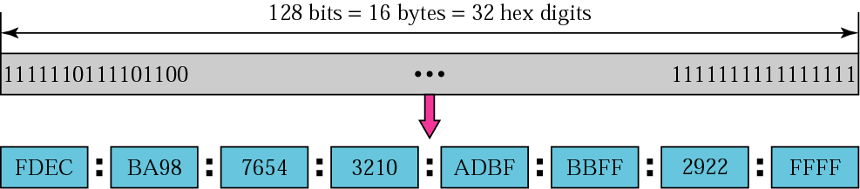
Figure 27.1 IPv6 address
TCP/IP Protocol Suite

Slide 5
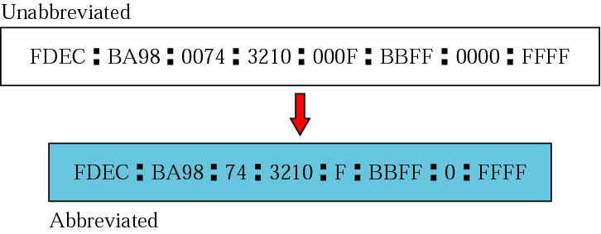
Figure 27.2 Abbreviated address
TCP/IP Protocol Suite

Slide 6
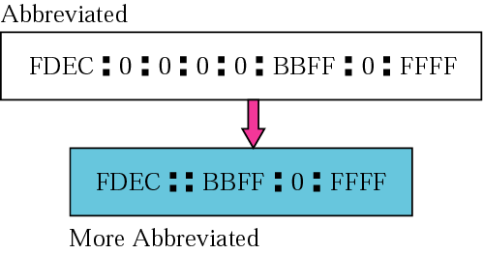
Figure 27.3 Abbreviated address with consecutive zeros
TCP/IP Protocol Suite

Slide 7
27-2 PACKET FORMAT
The IPv6 packet is shown in Figure 27.1. Each packet is composed of a mandatory base header followed by the payload. The payload consists of two parts: optional extension headers and data from an upper layer. The base header occupies 40 bytes, whereas the extension headers and data from the upper layer contain up to 65,535 bytes of information.

Slide 8
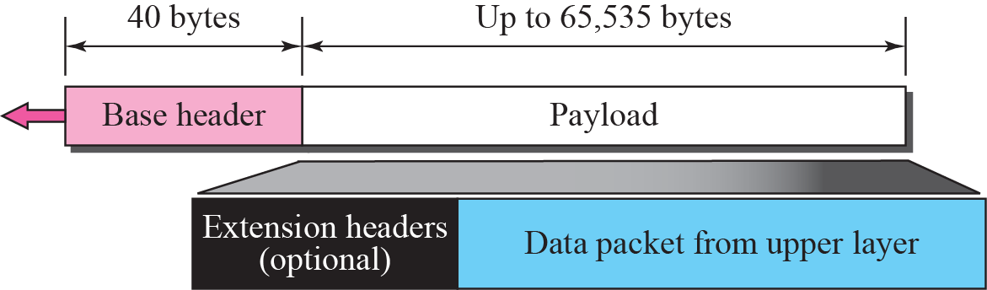
Figure 27.1 IPv6 datagram

Slide 9
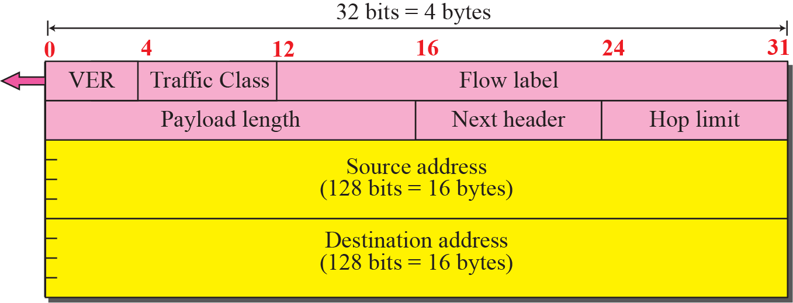
Figure 27.2 Format of the base header

Slide 10
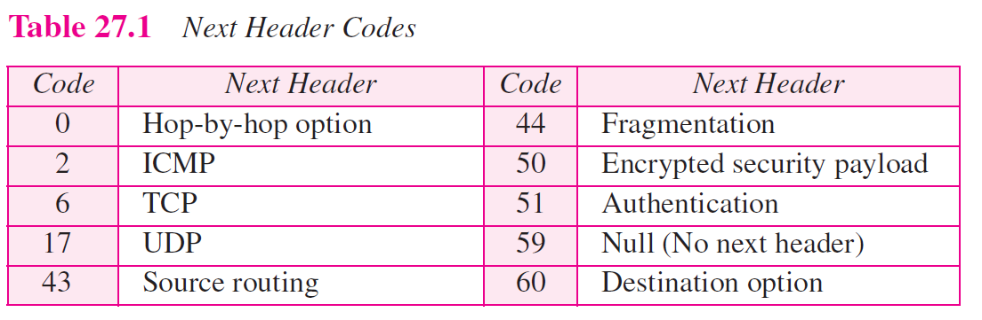

Slide 11
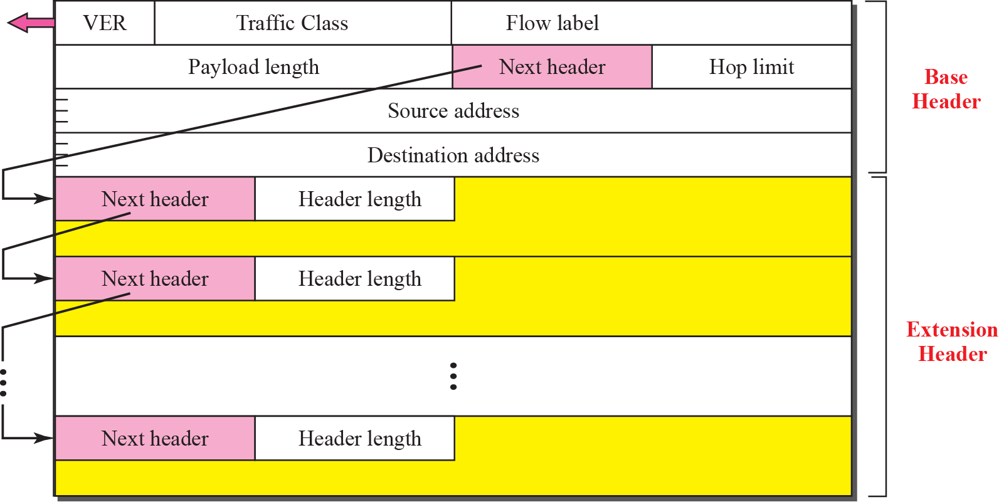
Figure 27.3 Extension header format

Slide 12
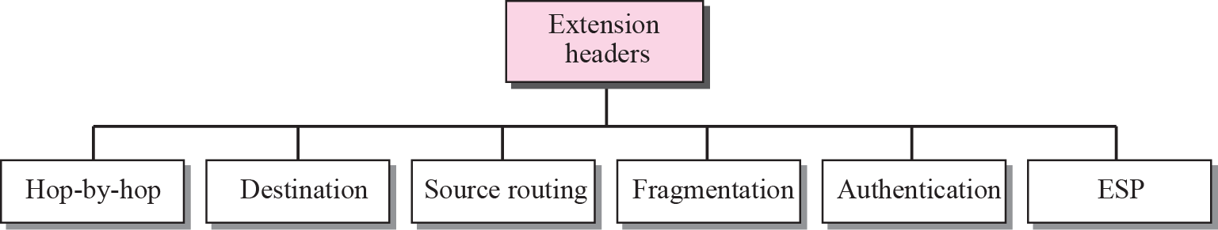
Figure 27.4 Extension header types

Slide 13
Figure 27.5 Hop-by-hop option header format

Slide 14
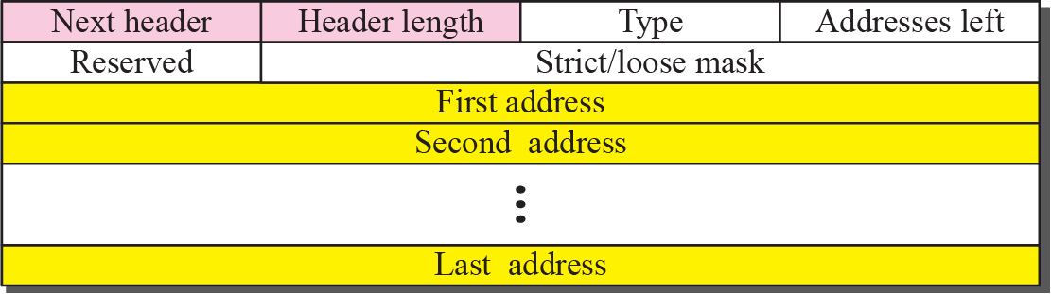
Figure 27.10 Source routing

Slide 15
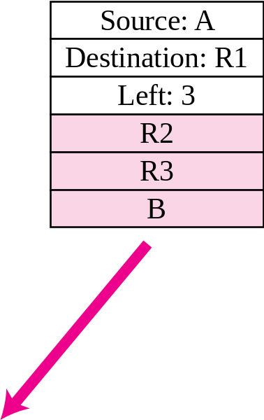
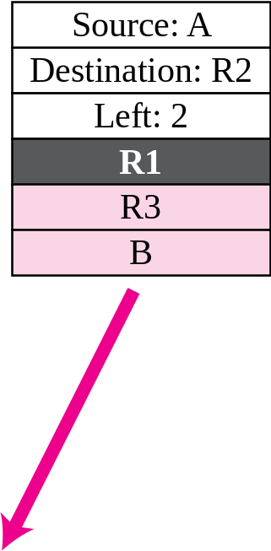
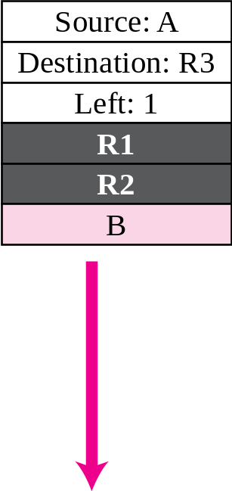
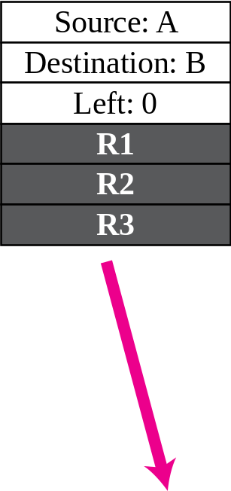
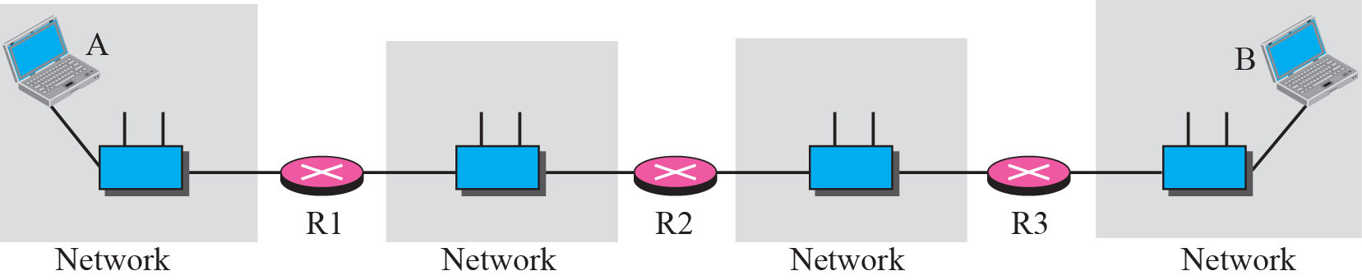
Figure 27.11 Source routing example

Slide 16

Figure 27.13 Authentication

Slide 17
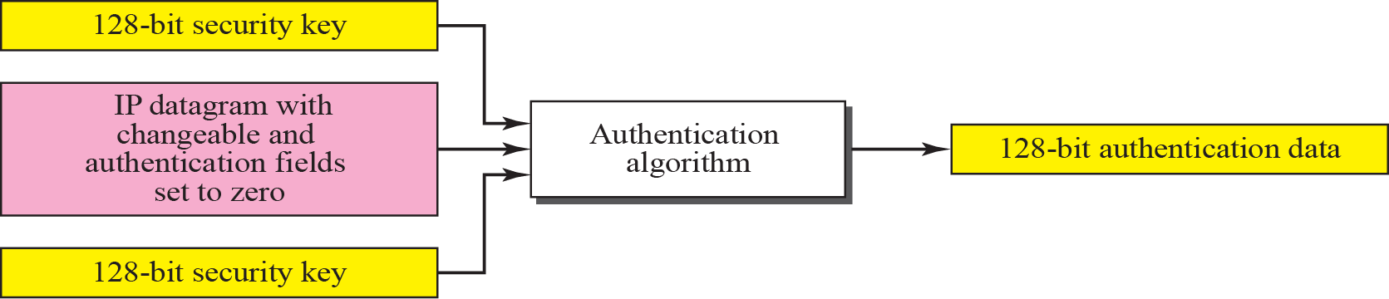
Figure 27.14 Calculation of authentication data

Slide 18
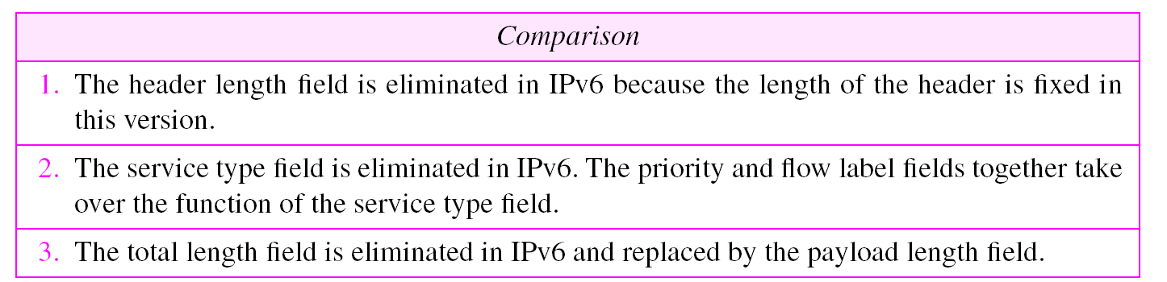
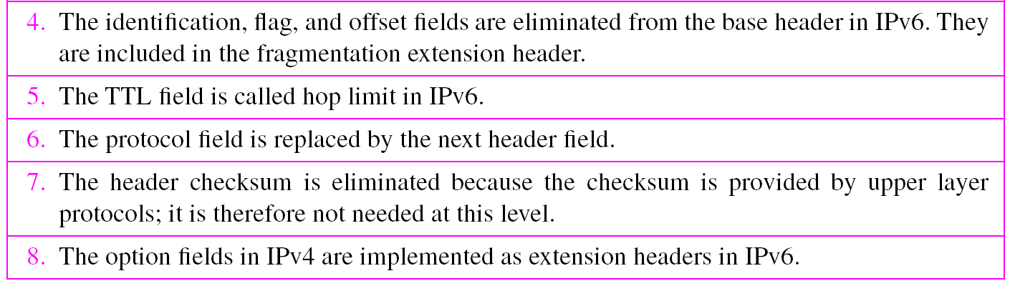
Table 27.5 Comparison between IPv4 and IPv6 packet header
TCP/IP Protocol Suite

Slide 19
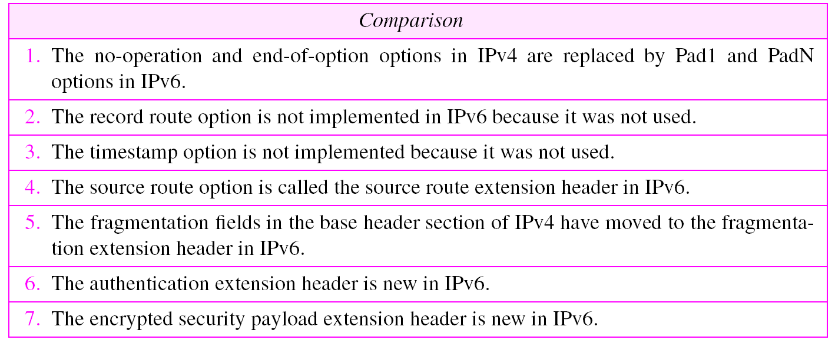
Table 27.6 Comparison between IPv4 options and IPv6 extension
headers
TCP/IP Protocol Suite

Slide 20
27-3 TRANSITION FROM IPv4 TO IPv6
Because of the huge number of systems on the Internet, the transition from IPv4 to IPv6 cannot happen suddenly. It will take a considerable amount of time before every system in the Internet can move from IPv4 to IPv6. The transition must be smooth to prevent any problems between IPv4 and IPv6 systems. Three strategies have been devised by the IETF to help the transition (see Figure 27.16).

Slide 21
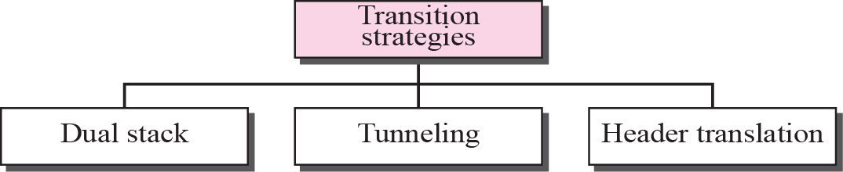
Figure 27.16 Three transition strategies

Slide 22
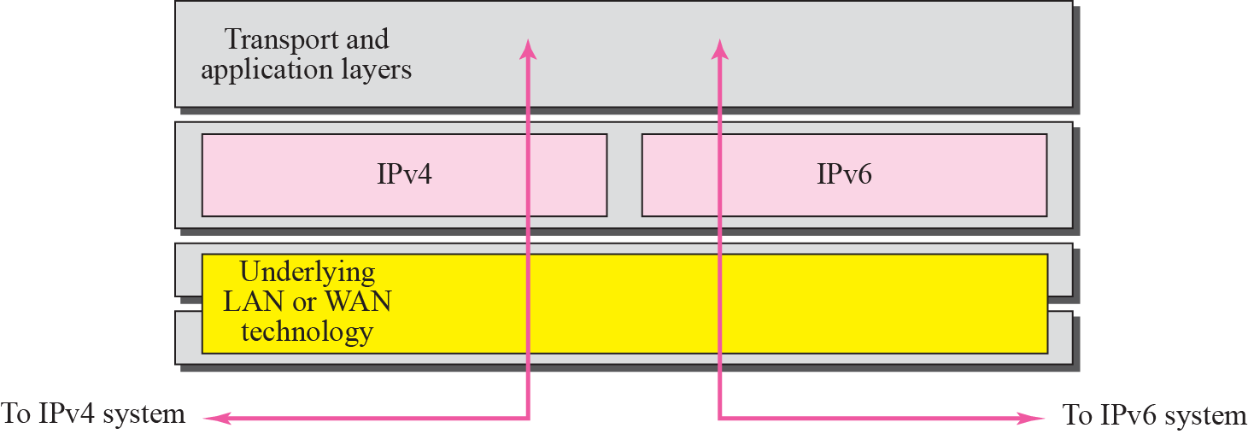
Figure 27.17 Dual stack

Slide 23
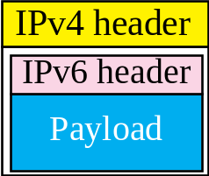
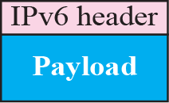
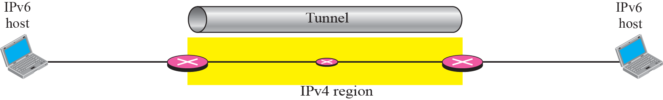
Figure 27.18 Tunneling strategy

Slide 24
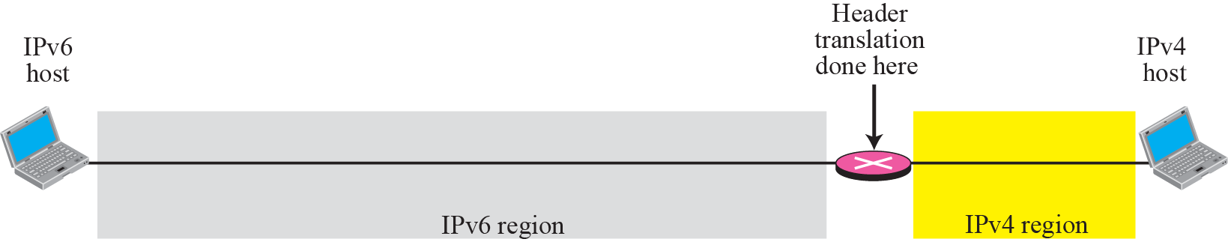
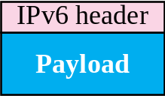
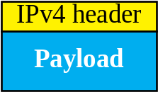
Figure 27.19 Header translation strategy

Slide 25
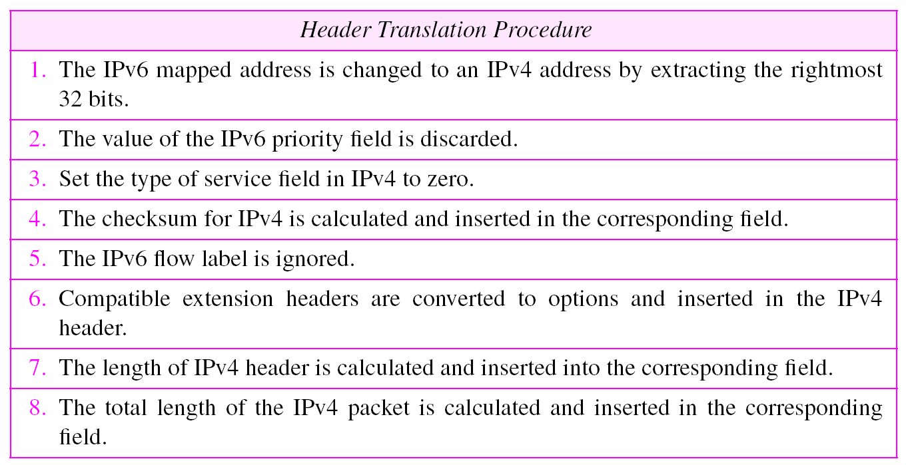
Table 27.9 Header translation
TCP/IP Protocol Suite

